Slide 1





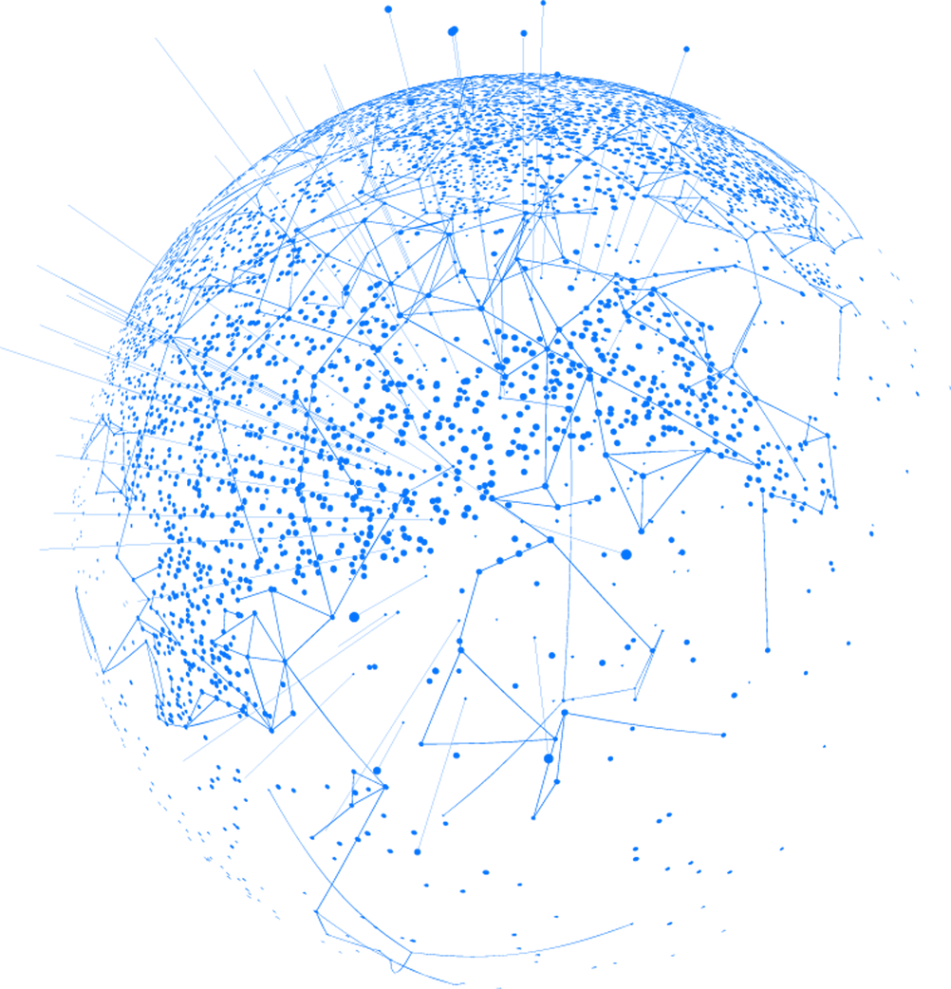
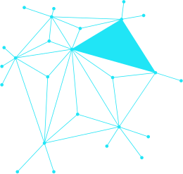
IMPLEMENTING SECURITY MEASURES FOR DESKTOP AND MULTI-USER SYSTEMS
Avile Bantwini

Slide 2



INTRODUCTION
The rapid advancement of technology and the increasing interconnectedness of systems have significantly elevated the risk of cyber threats. These threats include malware attacks, data breaches, and unauthorized access to sensitive information. Securing desktop and multi-user system is critical to protecting personal data, maintaining organizational integrity, and ensuring operational continuity. According to the 2023 Cybersecurity Threat report by Symantec, cyberattacks have increased by 40% compared to previous year, highlighting the need for robust security measures. The objectives of this research are to identify key security strategies for desktop and multi-user best practices for enhancing security.
02

Slide 3

Anti-virus and anti-malware software are essential tools in defending against malicious software. These programs detect, quarantine, and remove harmful code before it can cause damage. .
SECURITY STRATEGIES FOR DESKTOP SYSTEMS
Firewalls act as a barrier between a trusted internal network and unstrusted external networks, such as the internet. They monitor incoming and ongoing traffic and enforce security policies to block unauthorized access
03

Slide 4

Implementing the principle of least privilege ensures that users have the minimum level of access necessary to perform their duties
SECURITY STRATEGIES
Directory services like Active Directory manage user identities and access permissions, enhancing security in multi-user environments
Securing network communications is vital in protecting data transmitted between systems
04

Slide 5

Budget and personnel limitations can hinder the implementation of comprehensive security measures. Organizations must prioritize their security investments and optimize the use of available resources.
CHALLENGES IN IMPLEMENTING SECURITY MEASURES
User behavior plays a critical role in maintaining security. Despite technical safeguards, human error remains a significant vulnerability. Educating users about security best practices and fostering a culture of compliance is essential
05

Slide 6
BEST PRACTICES
Training
Response Plan
Regular training and awareness programs help users recognize and respond to security threats. Effective training should cover topics such as phishing attacks, safe browsing practices, and password management
An incident response plan outlines the steps to be taken in the event of a security breach. It includes identifying the incident, containing the damage, eradicating the threat, and recovering from the attack
06

Slide 7

CASE STUDIES AND EXPERT INSIGHTS
A multinational corporation implemented a multi-layered security strategy, including MFA, encryption, and regular security training. This resulted in a 50% reduction in security incidents. A healthcare organization adopted Zero Trust Architecture, which significantly improved its security posture and compliance with regulatory requirements
John Dube, a cybersecurity expert, emphasizes the importance of maintaining an adaptive and proactive approach to cybersecurity. Continuous learning and updating security measures are key to staying ahead of threats (wilson, 2014).
07

Slide 8


Thynk Unlimited
CONCLUSION
•Identified key strategies for desktop and multi-user systems
•Explored challenges and proposed best practices
•Anti-virus, firewalls, encryption, MFA for desktop security
•Access control, network security, continuous monitoring for multi-user systems
•Future research: AI-driven threat detection, advanced encryption technologies
08

Slide 9
REFERENCES
Boonkrong. (2020). Multi Factor Authentication. Authentication and acess Control.
Hancok. (2019). Internet Firewall. Network Security .
Rouwet. (2022). Open radio access network overview. Open Radio Access Network (O-RAN) Systems Architecture and Design .
Roy. (2024). A General Walkthrough of the Cyber-Physical Systems Concerning Security Threats and Safety Measures. Intelligent Security Solutions for Cyber-Physical Systems.
Ruj, S. &. (2016). Publicly Verifiable Secure Cloud Storage for Dynamic Data Using Secure Network Coding. Proceedings of the 11th ACM on Asia Conference on Computer and Communications Security.
WAN. (2020). A Robust Cloud Security Architecture based on Distributed Servers, User Authentication, and AES, Blowfish Encryption Techniques. Journal of Advanced Research in Dynamical and Control Systems.
wilson. (2014). Control-System Cybersecurity: Staying Ahead of Evolving Threats. Journal of Petroleum Technology.
09

Slide 10


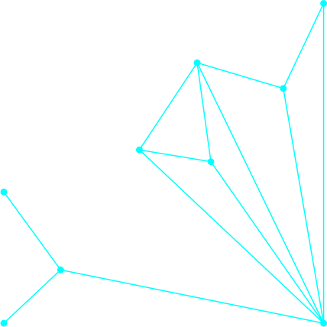
Thank For your time and attention

